Slide 1
IKMAN.LK ONLINE AD SOLUTIONS

Slide 2
About ikman.lk
Who are we
- Ikman.lk is a classifieds website which facilitates buyers and sellers to buy and sell almost anything
- Ikman.lk is Sri Lanka’s largest marketplace
- We Launched in 2012
- We are Swedish owned
- Over 350 employees

Slide 3
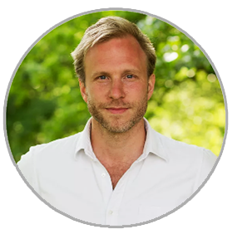
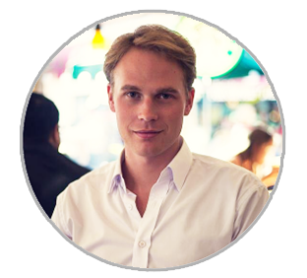
About ikman.lk
Nils Hammar started his career as one of the first employees at Skype, working with product development and marketing.
Nils co-founded Saltside in 2011.
Before becoming an entrepreneur Alexander worked as an investment banker in Stockholm focusing on M&A transactions. Alexander holds a Bsc from Stockholm School of Economics

Slide 4
Our Investors
INVESTMENT AB KINNEVIK
Kinnevik's main areas of focus are the Communications, e-Commerce, Entertainment and Financial Services sectors. Kinnevik has a significant stake in over 50 companies that operate in more than 80 countries across 5 continents,
HILLHOUSE CAPITAL
Hillhouse Capital Management is a long-term equities investor with over $16 billion under management.
Hillhouse invests globally with a focus in Asia.
BRUMMER & PARTNERS
Brummer & Partners is a leading European hedge fund manager that brings together managers with different management strategies in a corporate group. Together, we manage SEK 108 billion * on behalf of private individuals, companies and institutional investors. Brummer & Partners has offices in seven countries and is headquartered in Stockholm. The group has about 400 employees

Slide 5
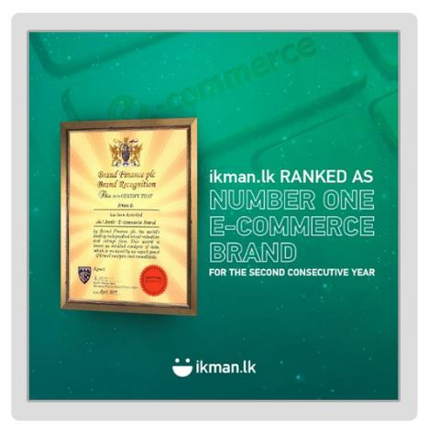
The Recent Achievements
LMD
Brand Finance

Slide 6
Sri Lanka’s Standpoint

Slide 7
The Success of ikman.lk

Slide 8
And something more about ikman.lk
Ikman.lk is the only local website that is listed in the top 10 web sites in Sri Lanka.
Source : similarweb.com

Slide 9
Benefits of Online Advertising

Slide 10
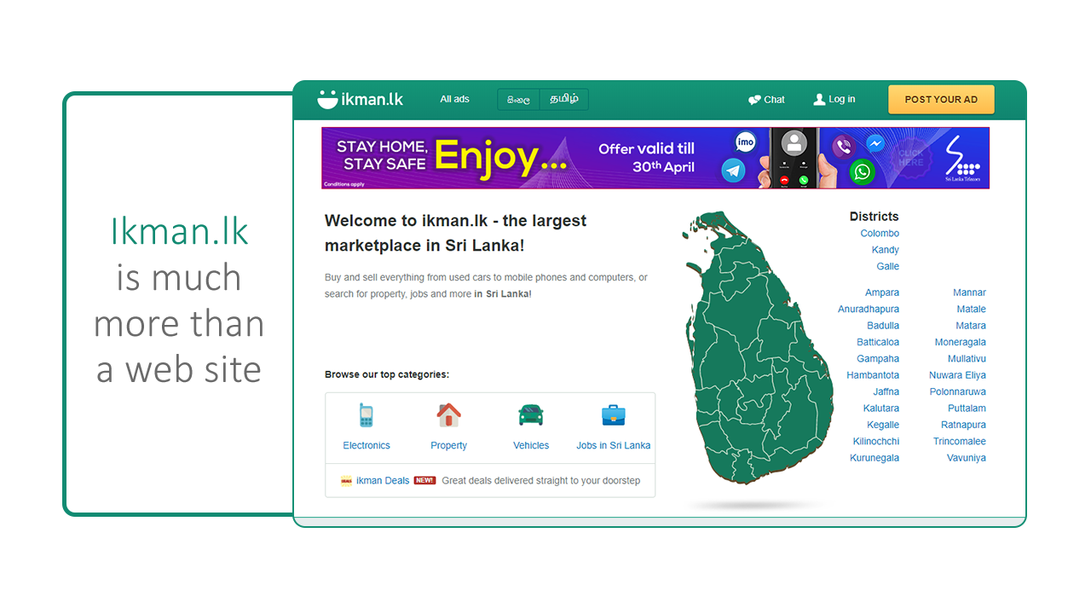

Slide 11
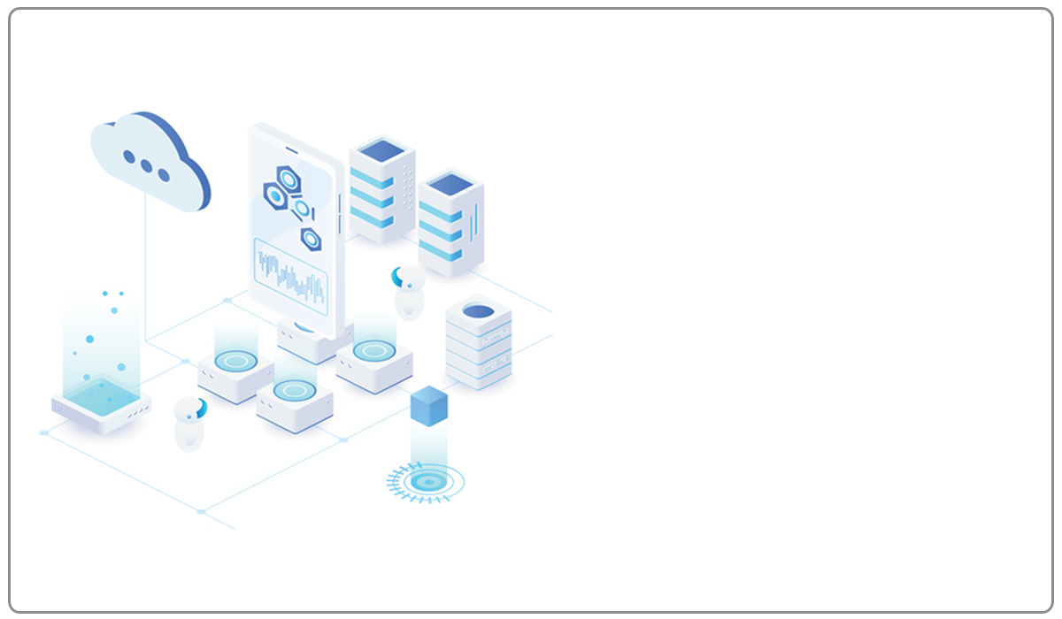
It’s a
Powerhouse of
Data
Tracking the
User Behaviour

Slide 12
We have
3.5M
Unique Visitors per month
Making it the
largest Audience Pool
in the Country

Slide 13
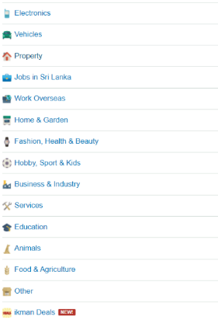
And
Most important
Audience pool
for businesses

Slide 14
We know the people who are looking for
During these days ……

Slide 15
And
What kind of product they are looking for
and which brand / model
the price range
from where
since when
Etc……

Slide 16
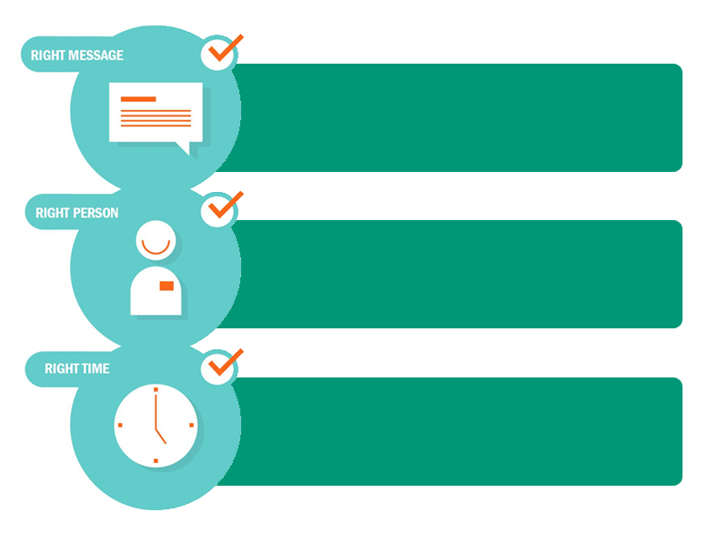
And deliver the
Right Message
To the
Right Person
At the
Right Time
Via a display banner on ikman.lk

Slide 17
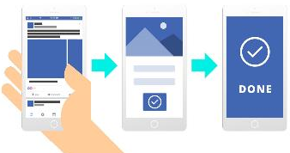
And follow up the same user in their digital journey
Get the lead
Get the lead

Slide 18
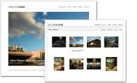
Who else can do this ?
Another site ?
NO
Why ?
No one in SL market has a target specific cookie pool / database like ikman.lk
Agency ?
NO
Why ?
They do not have a property or a cookie pool / database like ikman.lk

Slide 19
User Classification

Slide 20
Transfer our strengths / Audience
To
Result Oriented
Digital Advertising Solutions

Slide 21
To help you grow your business, ikman online ad solution is built around two principles:
Relevance and Results
Relevance
Results
Ikman ad solution helps you connect with the right audience, at the right time, with the right message.
We use our smart technology and expert knowledge to create, manage, and optimize your campaigns
in real time basic.
so you can get the most out of your investment.

Slide 22
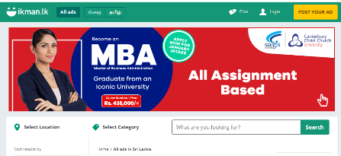
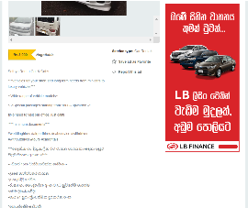
Something more about ikman ad solutions
Benefits of Adverting on ikman.lk
Capable of advertising with local languages and reaching 50% of internet users in Sri Lanka.
Uncluttered environment
Followed industry accepted number of ads per page ( 3 Banners )
Banner in prominent locations taking into consideration the user navigation

Slide 23
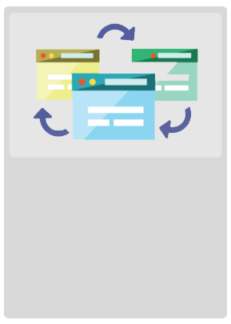
Something more about ikman ad solutions
Benefits of Adverting on ikman.lk
Capability of having better optimization methods.
Rotate Creatives in four different methods
Date / Time wise targeting
Frequency Capping

Slide 24
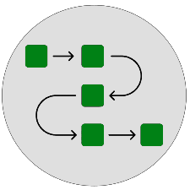
Something more about ikman ad solutions
Rotate creatives
Weighted
Sequential:
Even:
Optimized ( Default )
Creatives rotate in the order you specify. We can enter a number between 1 and 4.
Creatives rotate evenly.
Creative with the highest CTR will be shown more often.
Creatives rotate at a frequency you specify

Slide 25
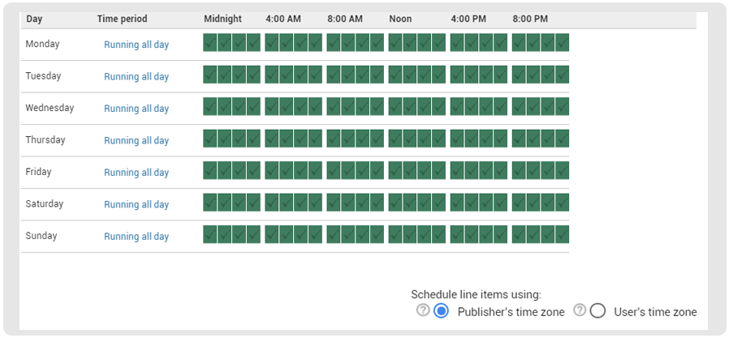
Something more about ikman ad solutions
Day and time
Specify which days of the week and hours of the day the line item can be delivered.

Slide 26
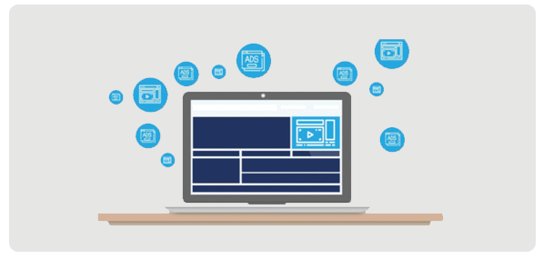
Something more about ikman ad solutions
Frequency Cap
Limit how often the line item can be delivered to each user.
You can set more than one frequency cap, limiting the number of views per hour, per day, and so on.

Slide 27
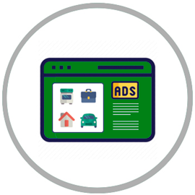
Ikman Online Ad Solution
Ikman online ad solution proposition taken to the next level
Persona Based Targeting
Other Solutions
Content Targeting
Ikman Search

Slide 28
Content Targeting

Slide 29
Content Targeting
Target potential customers based on the category / subcategory that they are looking for

Slide 30
It’s something beyond the direct banner placement
Now we can categorize users based on their behaviour

Slide 31
Example 1
ABC is a banking client who has a leasing product to be promoted.
Propositions :
Lowest interest rates
Door to door service
Easy settlement of existing leasing
Hybrid and Electric leasing
Lowest interest rates
Hybrid and Electric leasing
Door to door service
Easy settlement of existing leasing
Target below 3 M vehicles seekers
Target Hybrid and Electric vehicle seekers
Target Above 7 M vehicle seekers
Target 3M – 7M vehicle seekers

Slide 32
Ikman Search

Slide 33
Ikman Search
For some industries,
ikman has more search queries than Google
Once you buy the keyword, you own it no one can compete against you. Block your competitor.
The only one display driven search advertising provider in Sri Lanka
People use search engines because they’re looking for something. Being visible in search results page means being where the customers are.
Only Google and Ikman can offer Search advertising in Sri Lanka. But ikman.lk is the only display driven search advertising provider in Sri Lanka
Only Google and Ikman can offer Search advertising in Sri Lanka. But ikman.lk is the only display driven search advertising provider in Sri Lanka

Slide 34
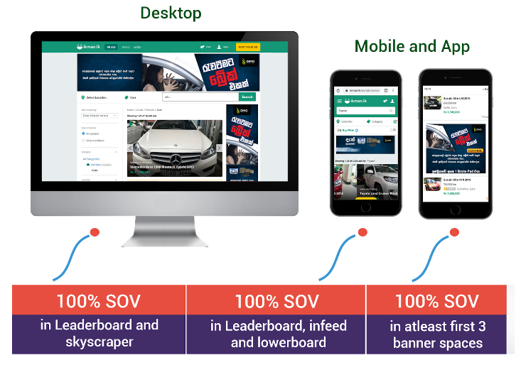
Ikman Search
This is how it appear

Slide 35
Type of Key Words
Parent Keywords vs Child Keywords
Parent Key Words
Child Key Words
Parent keywords are the top level keywords which are not categorized further
Child keywords are sub keywords under parent keywords. One parent keyword can have multiple child keywords
E:G
E:G
Audi
Toyota
Mitubishi
Samsung
Nokia
Audi Q7
Audi A4
Toyota Vitz
Toyota Aqua

Slide 36
Type of Key Words
Own Keywords + Closest Competitors + Middle Level Competitors
Own Keywords
Closest Competitors
Middle Level Competitors
Own keywords means the key words related to your own brand and model
Competitive keywords which are directly competing with your own keywords
Competitive keywords which are not directly competing with your keywords, but can make in impact on your keywords
E:G
E:G
E:G
Audi Q7
Nissan X-Trail
Audi Q3
Mitsubishi XPander
Peugeot
Peugeot 3008

Slide 37
Ikman Search
Note :
The search solution is purely based on the user behaviour. So the campaign duration is based on
Number of keywords you select
The number of impression you buy
Number of search queries for selected
key words
The trend of searching product by users
So before executing a campaign, having a proper plan will help to get good result and run the campaign smoothly.

Slide 38
Persona Based Targeting

Slide 39
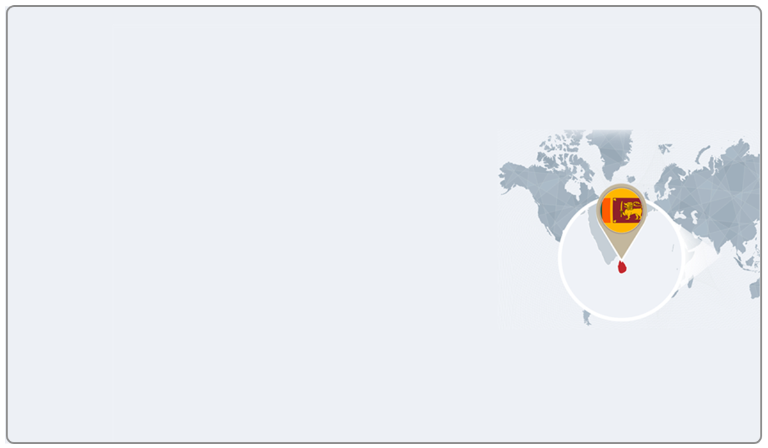
In Sri Lanka, 8 M – 9 M people
patronizes the Internet
out of them
3.3 M – 3.5 M are using ikman.lk
out of them
90% are from Sri Lanka

Slide 40
we follow the industry accepted inventory buying model
CPM - Cost Per Mille

Slide 41
Persona Based Advertising
Category
Level
Classification
And
Targeting
URL
Targeting
In detailed view page
Persona
Based
Advertising
Search
Keyword
Targeting
In SERP

Slide 42
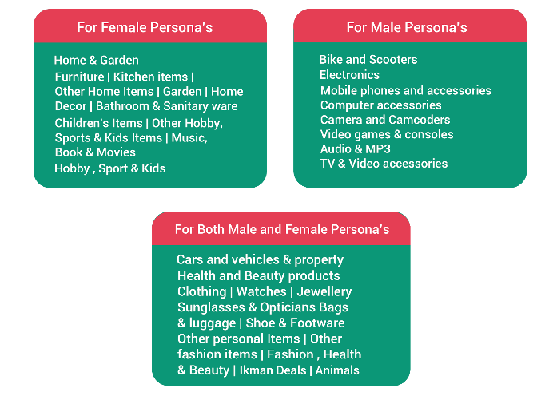
Persona Based Advertising
So now Ikman.lk can categorize users based on their lifestyle
Category level

Slide 43
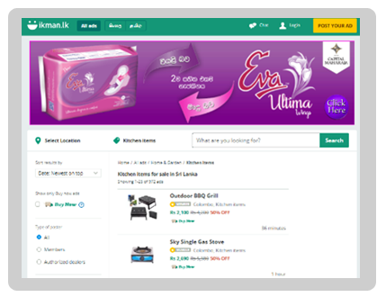
Persona Based Advertising
So now Ikman.lk can categorize users based on their lifestyle
Category Level Targeting
Identify the most relevant categories and place the advertisement
E:G
To target female products, home and garden section is the ideal place

Slide 44
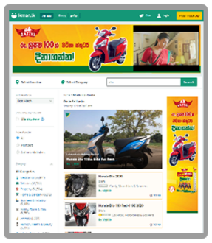
Persona Based Advertising
So now Ikman.lk can categorize users based on their lifestyle
Search Keyword Targeting in SERP Page
Identify the keyword searches that the users are using and place the advertisement accordingly
E:G
When the clients are having consumer promotions and giving away scooters, target the scooter searchers and place the advertisement

Slide 45
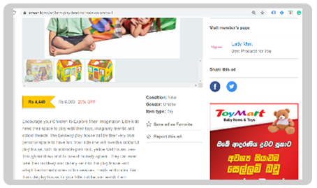
Persona Based Advertising
So now Ikman.lk can categorize users based on their lifestyle
URL Targeting in Detailed View Page
Identify the page that the user is viewing based on the URL of the page
and place the advertisement accordingly
If the client wants to target parents who are looking for toys for their kids, our system will read the url of the page and place the advertisement accordingly
E:G
Here, this URL includes kids-play which indicates this page has something related to kids toys

Slide 46
Some of creative Assets
Animated Banners
Separate Microsite
Video Banners
Demo
Demo
Demo
Demo
Demo
Demo
Rich Media Banners on interaction
Road Blocks
Hypo Banner
Demo
Demo
Demo
Demo

Slide 47
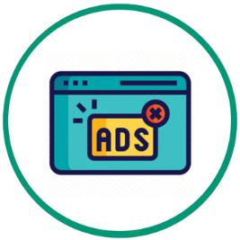
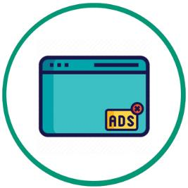
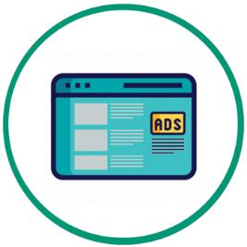
Other Solutions

Slide 48
Road Blocks
Roadblock advertising allows advertisers to own 100% of voice for a 7 days period and will be the first impression of the user in that given time period
The unique features of ikman.lk road block are
Road block will run across the site in all categories
and
Only 3 campaigns are allowed
( Allocation on first come first serve basic )

Slide 49
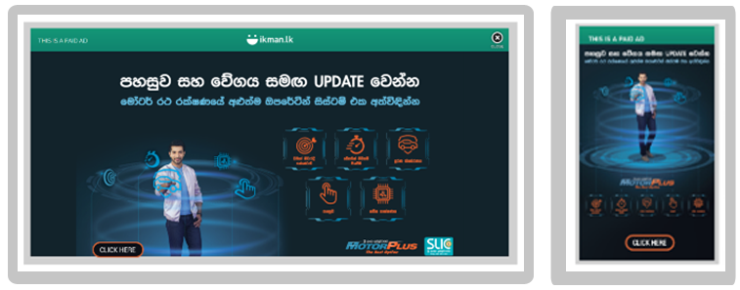
Road Blocks
This is how it appear
Desktop
Mobile / App
Demo

Slide 50
Hypo Banners
The hypo targeting banner will only show to an identified target audience assessed to directly match the target profile required for the campaign as close as possible
Has a sticky effect meaning it follows the user as they navigate the page
The banner is exclusive meaning space is not shared with any other client

Slide 51
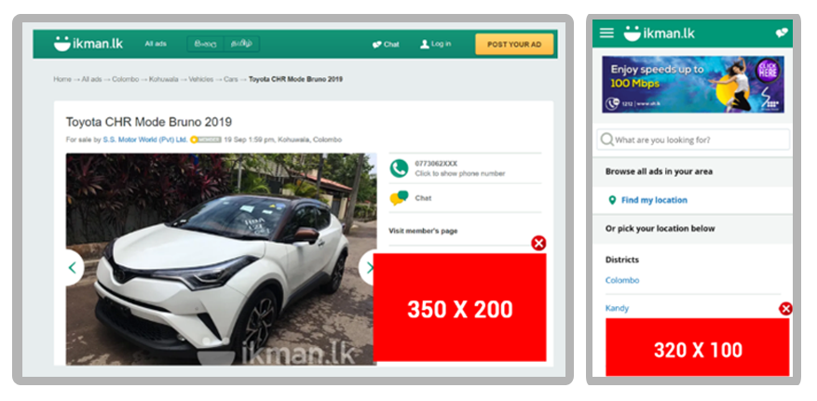
Hypo Banners
This is how it appear

Slide 52
Sticky Banners
Sticky ads are the ads that stay afloat when the user is viewing the content on a webpage. As the name implies, it sticks to the viewpoint throughout the user session on the page. In other words, sticky ads are always visible to the user , regardless of the scroll path.
100% Share of voice during the campaign period ( No rotation )
Can have interactive creatives

Slide 53
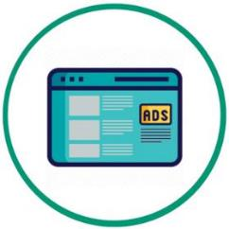
Native Ads
Native advertising is the use of paid ads that match the look, feel and function of the site in which they appear.
Desktop
Mobile

Slide 54
Benefits of Native Advertising
Native advertising is more trustworthy than traditional advertising
Can have 100% SOV in the placement
High prominent placement in the mobile device
( Over 70% of users are log in to ikman.lk via a mobile device )
Limitation of Native Advertising
Still key value targeting ( price , model etc.. ) is not available
Note :
The execution of native ads are done by the hard coded method, the campaign period should be minimum of 3 months

Slide 55
Measurements
By making everything transparent, a daily
Automated e mail will be sent to the specific email address via Google Ad Manager platform which can not be manipulated by any one.

Slide 56
Thank you for your time !

