Slide 1
DIGITAL MEDIA SOLUTION FOR SME ADVERTISERS

Slide 2
Did you know ?
Ikman.lk is the
Biggest web site
in Sri Lanka.

Slide 3
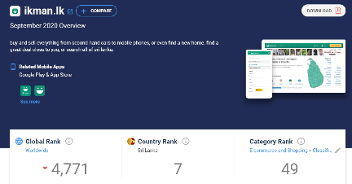
Did you know ?
ikman.lk is the
only local website
that is listed in the
top 10 websites in Sri Lanka.
Source : similarweb.com

Slide 4
Did you know ?
3.5 Million
People visit
ikman.lk every month

Slide 5
Did you know ?
ikman.lk has the lowest bounce rate among all websites in Sri Lanka
Bounce Rate – 8%
The time spent on ikman is very high compare to other websites
Time Spent – 11+ Minutes

Slide 6
Categories on ikman.lk
15 different categories on ikman.lk

Slide 7
Target the right Audience
Select the right category
and
Target your customers
Mobile phone category

Slide 8
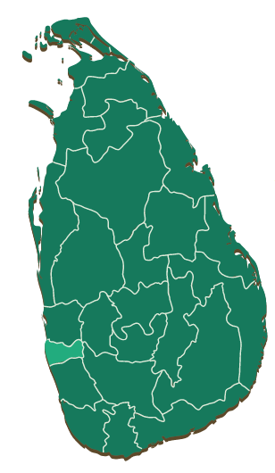
Target the right Audience
And
Target < mobile phone users >
in < Colombo >

Slide 9
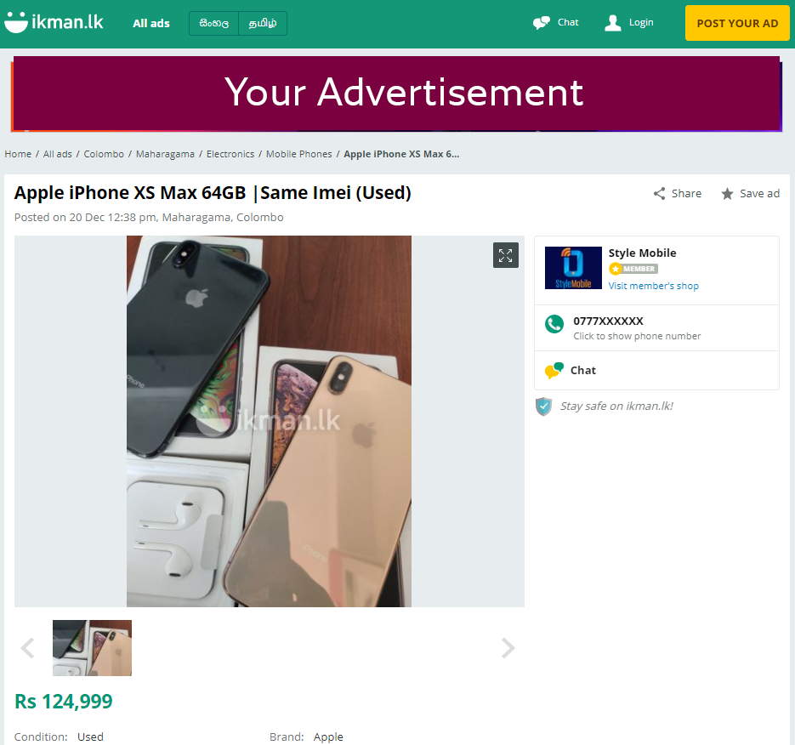
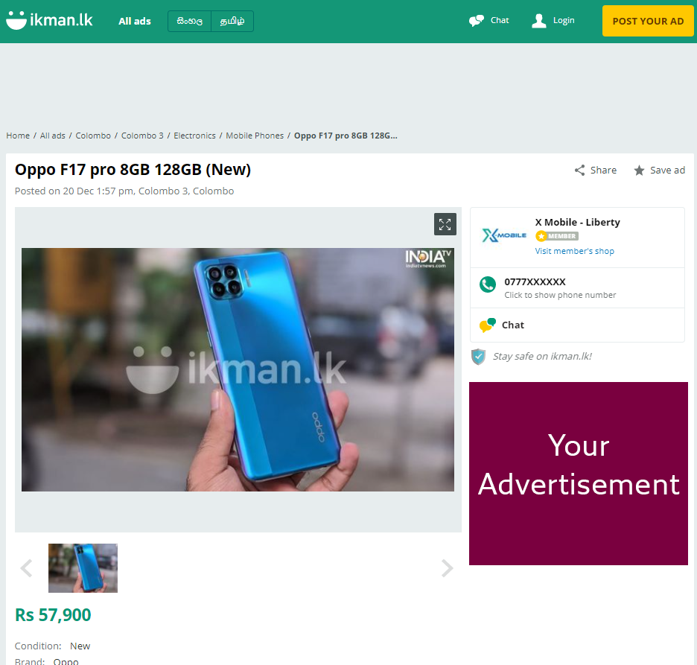
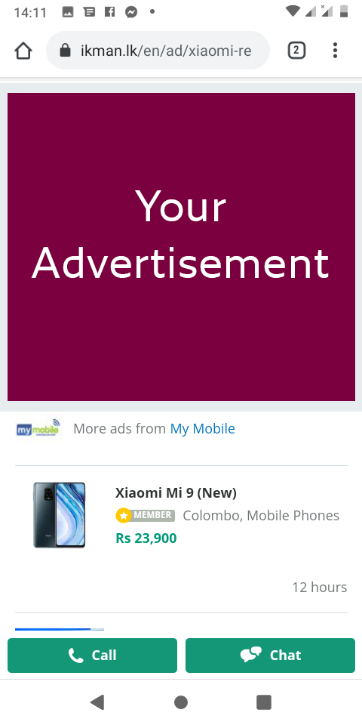
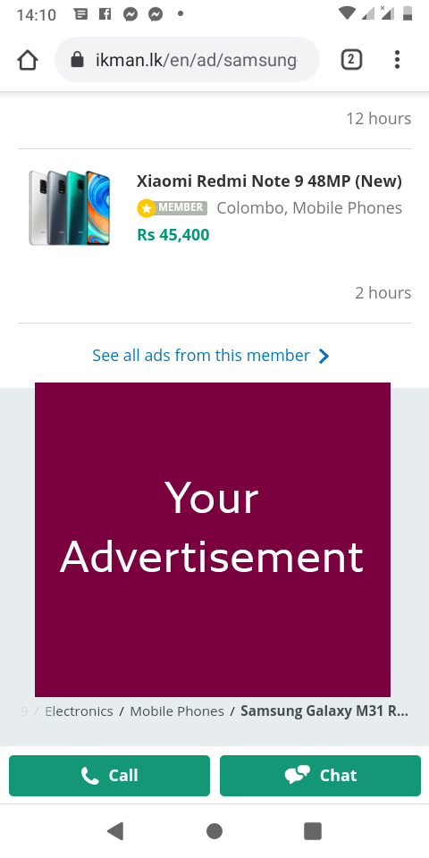
Banner Placements and Sizes
Mobile / App
Middle Banner
Mobile / App
Bottom Banner
Desktop – Top Banner
Desktop – Square Banner

Slide 10
Call to action
Once the user clicks on the banner , can be sent to :
Your Facebook Page
Microsite that we developed for you
Call your phone number
Your Website

Slide 11
Investment
Budget
Propose budget inclusive of VAT
:
Rs. 20,000
:
Banners and Microsite Development
:
FOC
Banners and Microsite Templates - < Link >

Slide 12
Thank you for your time !

